Slide 1
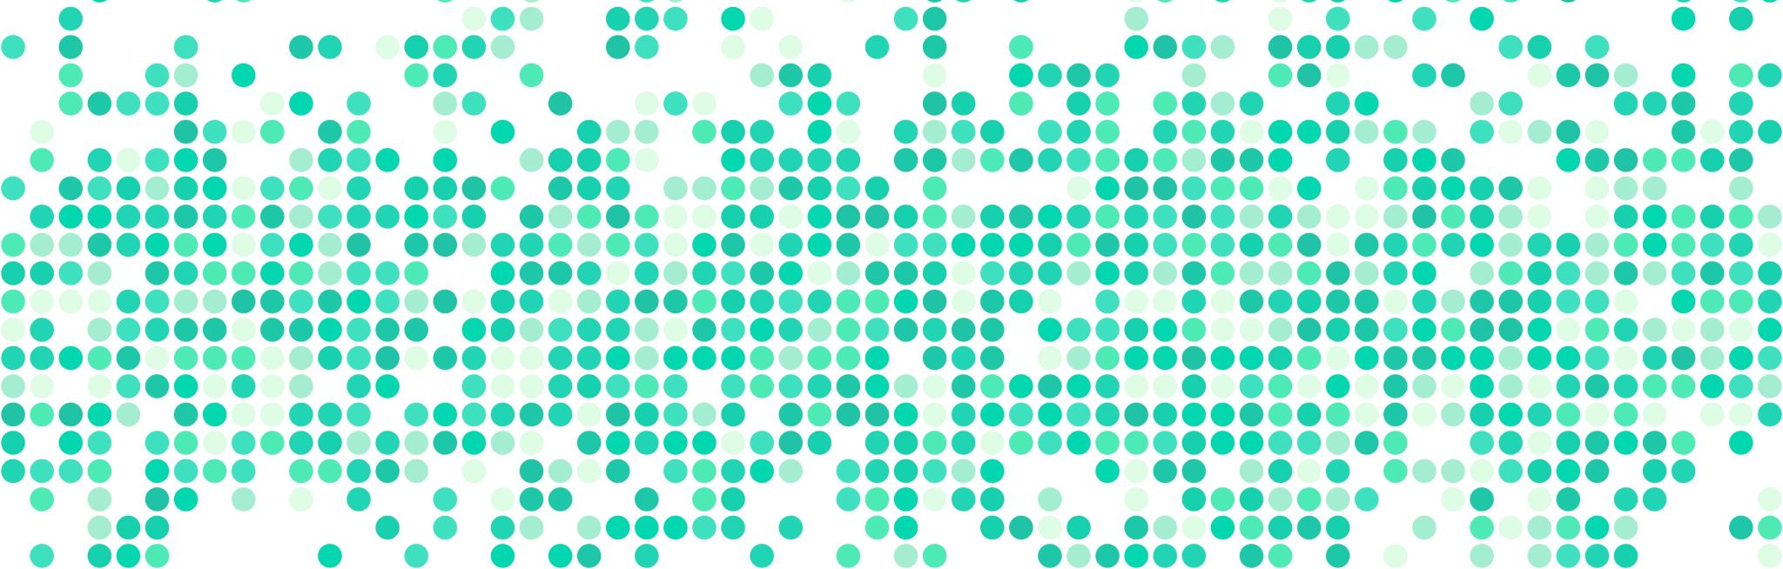
Crime and Inflation
Antonio Ortiz and Kurt Meyer

Slide 2
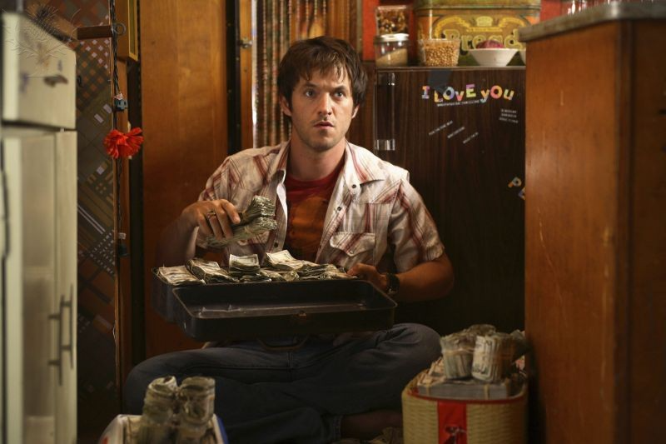

Research Question: Is there a relationship between rising inflation rates and crime?
Intuitively we expect money to be a major motivator when it comes to crime.
Academic research has been done over the years to answer this question.
However, we found nothing addressing recent inflation and crime concerns.
We do understand our analysis is rudimentary!

Slide 3
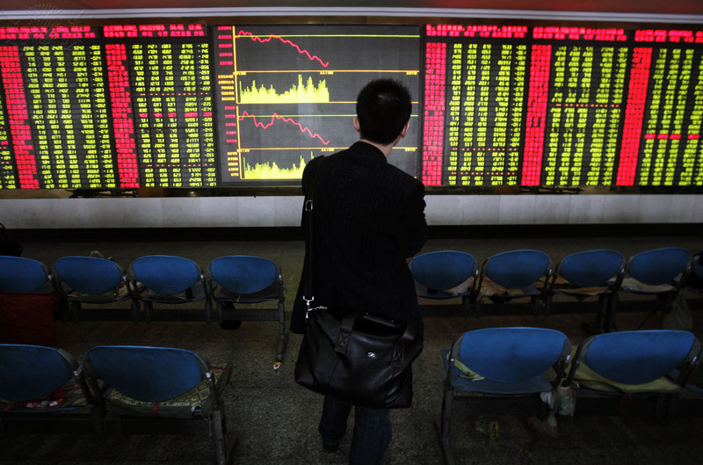
Datasets
We used two data sets.
Inflation data originated from the St. Louis Federal Reserve
Crime data came from the FBI Uniform Crime Reporting dataset and DisasterCenter

Slide 4
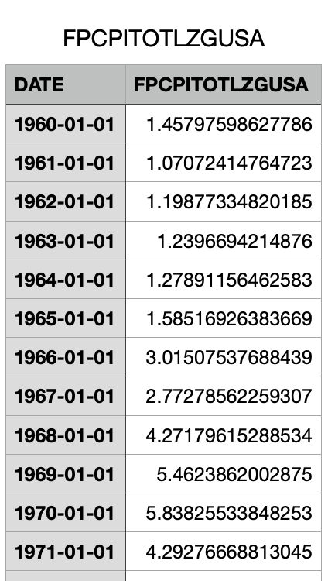
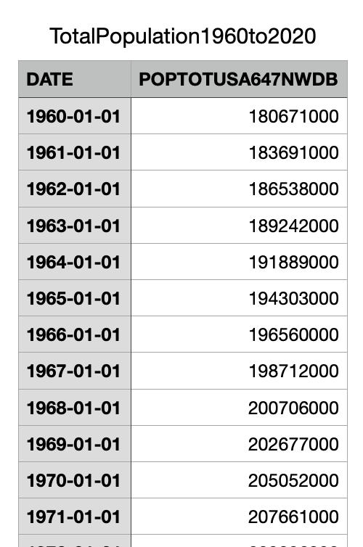
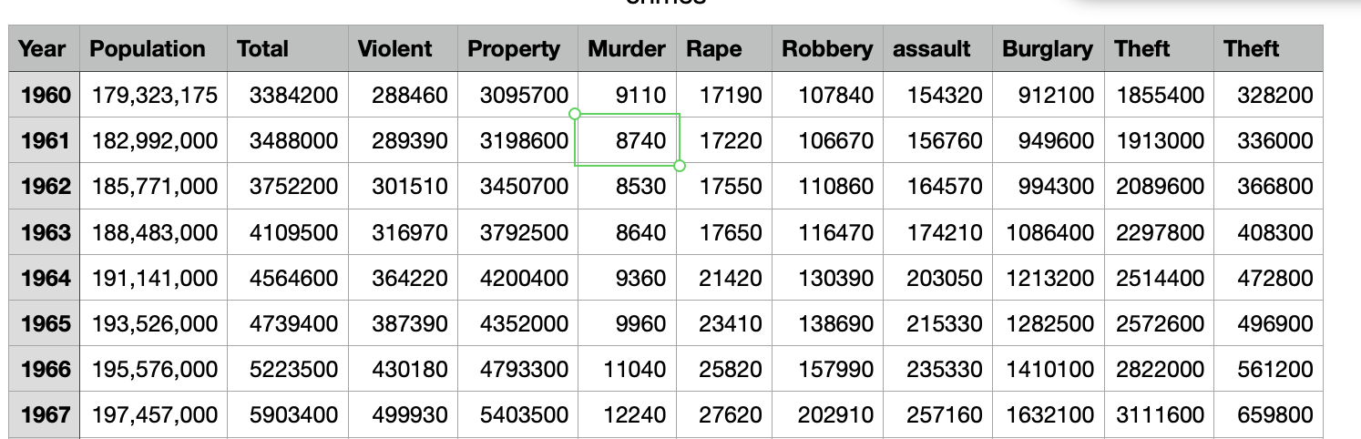
Data Preparation (Antonio)
Removal of outliers (only within 3 SDs)
Formatting dates
Converting crime data to per 100,000.

Slide 5
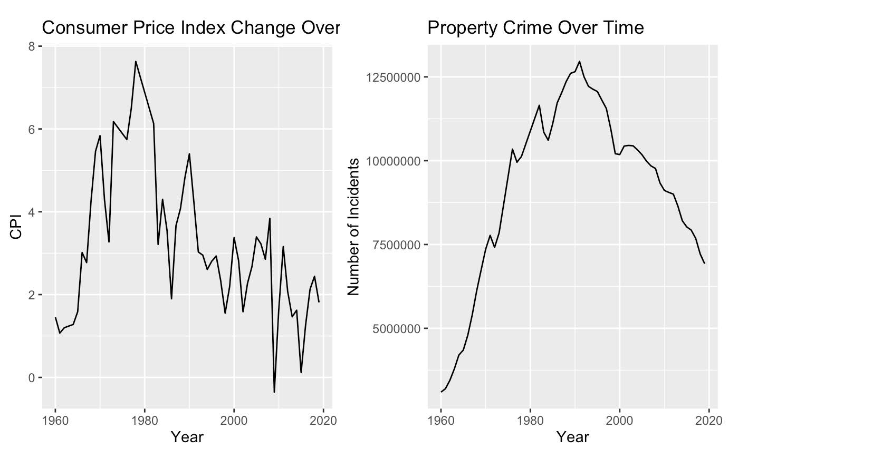
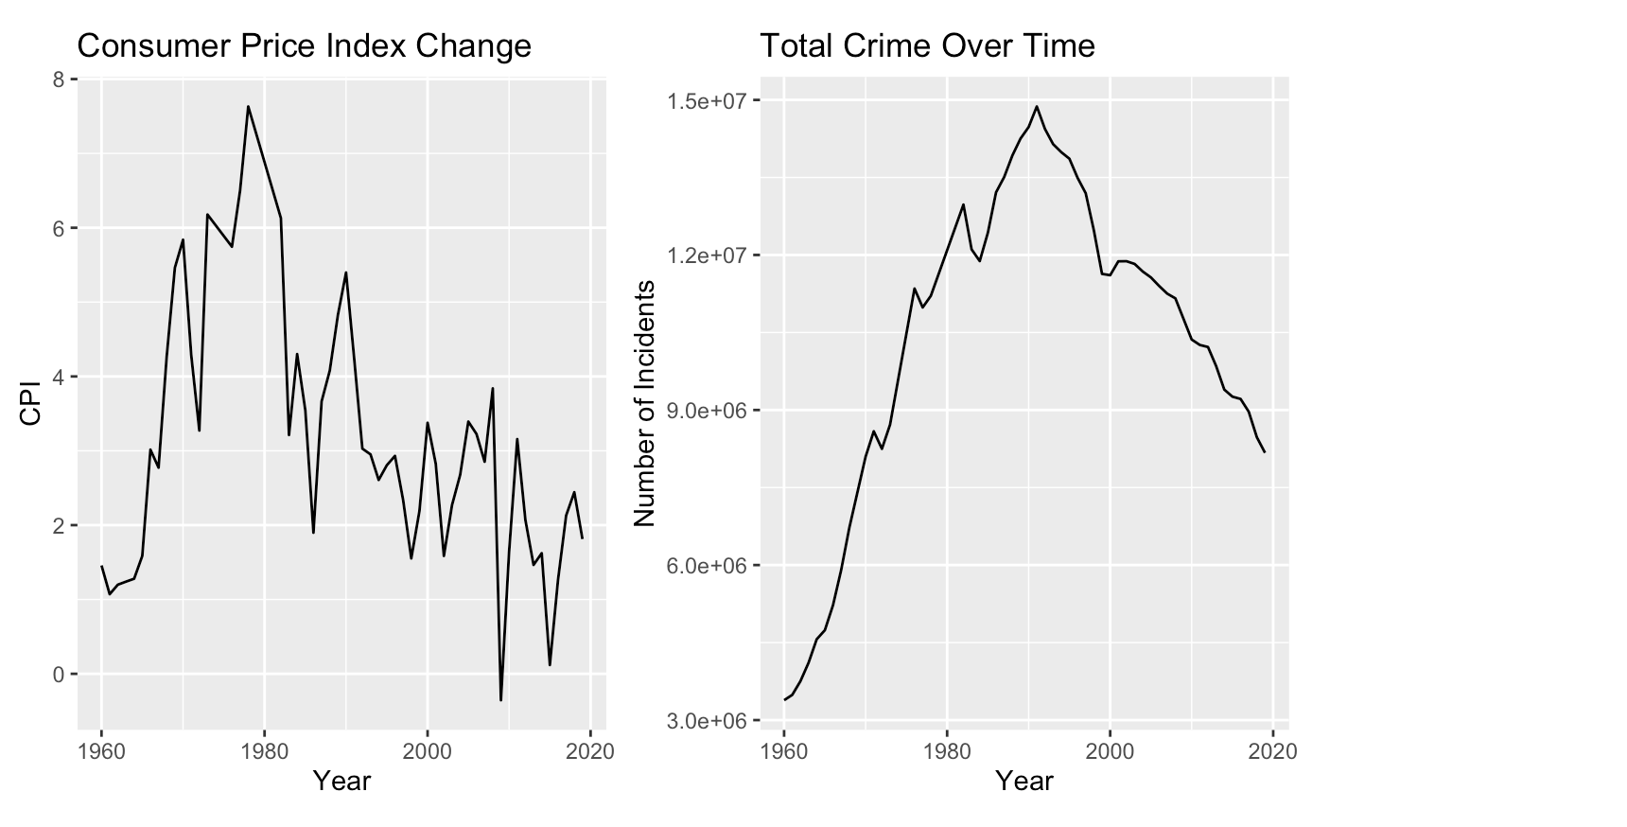
General Comparisons

Slide 6
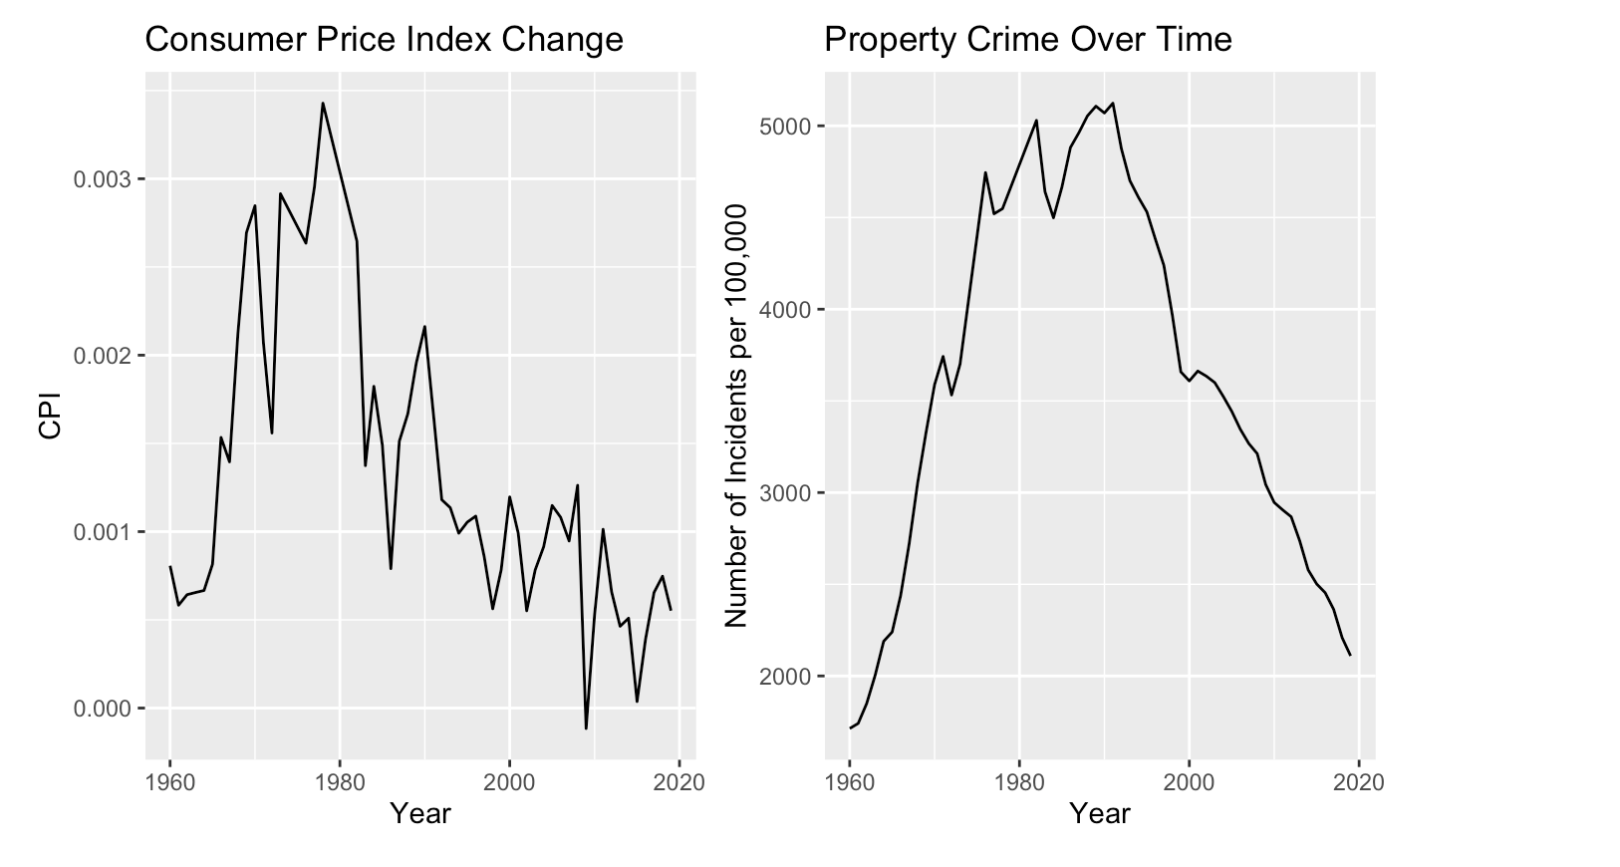
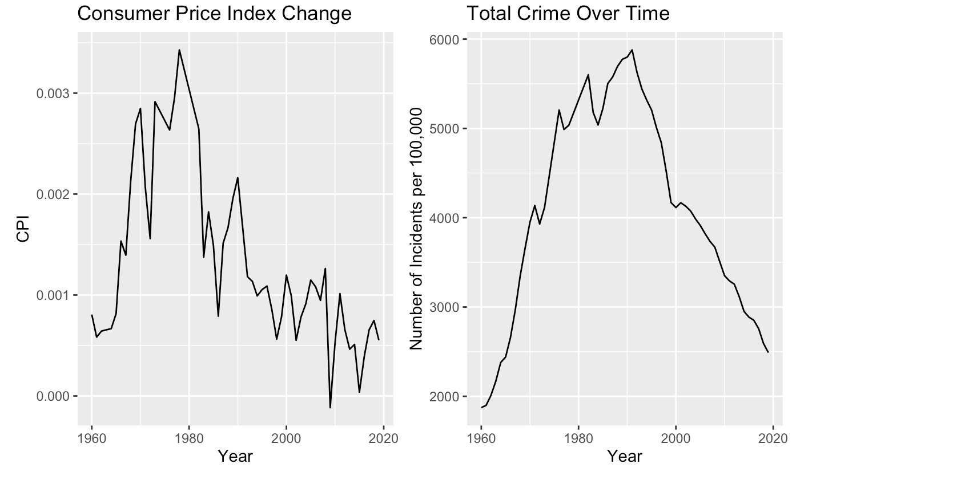
Per 100,000 Comparisons

Slide 7
Antonio’s Visualization Slides

Slide 8
Correlation Tests

Slide 9
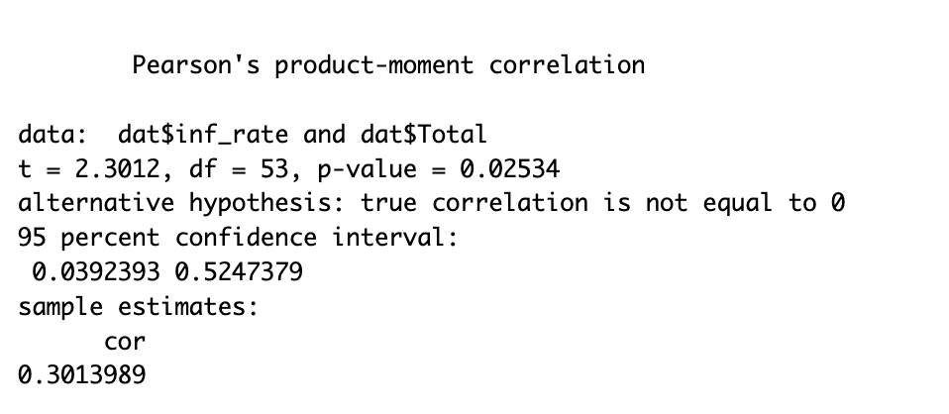
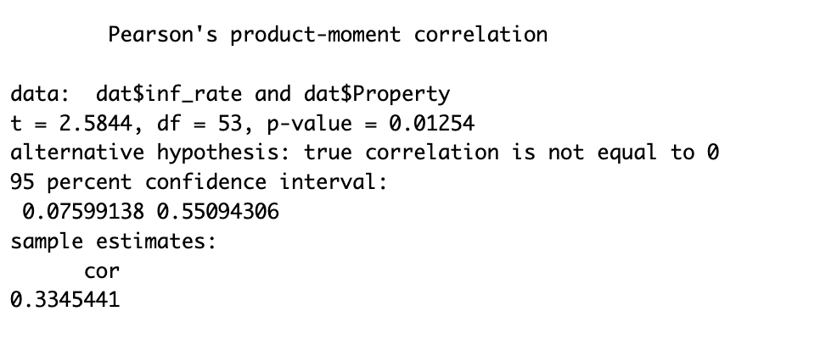
Correlation Tests on Totals

Slide 10
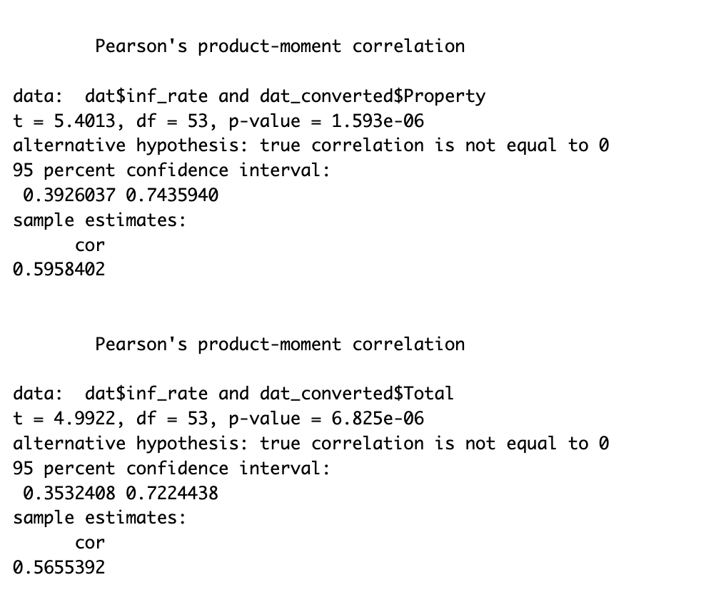
Correlation Tests on Crime Data Per 100,000

Slide 11
Granger Model

Slide 12
Conclusions
There is a moderate correlation between these two variables when crime is converted to per 100,000.
All correlation tests generated p-values under .05.

Slide 13
Models

Slide 14
Basic Linear Regression

Slide 15
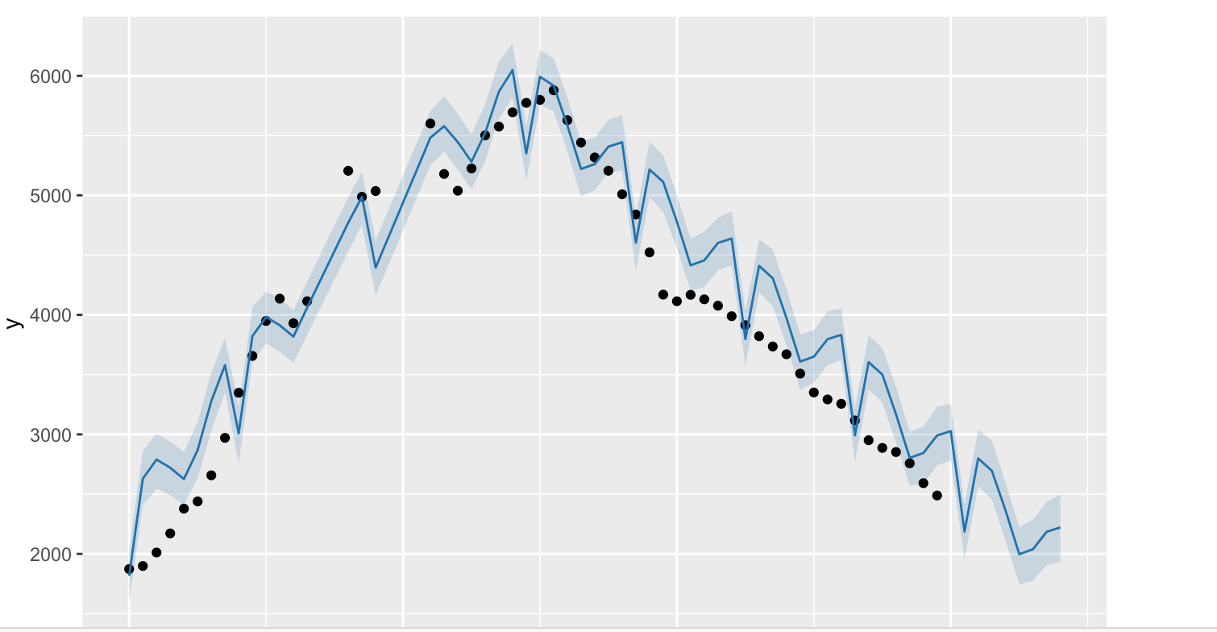
Facebook Prophet Prediction

